Slide 1
Lcd
LCD stands for Liquid Crystals Display
It is made from
When we build real life/real world electronics based projects, we need a medium/device to display output values and message

Slide 2
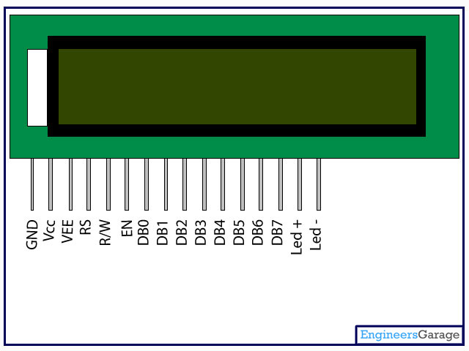
Lcd contd……

Slide 3
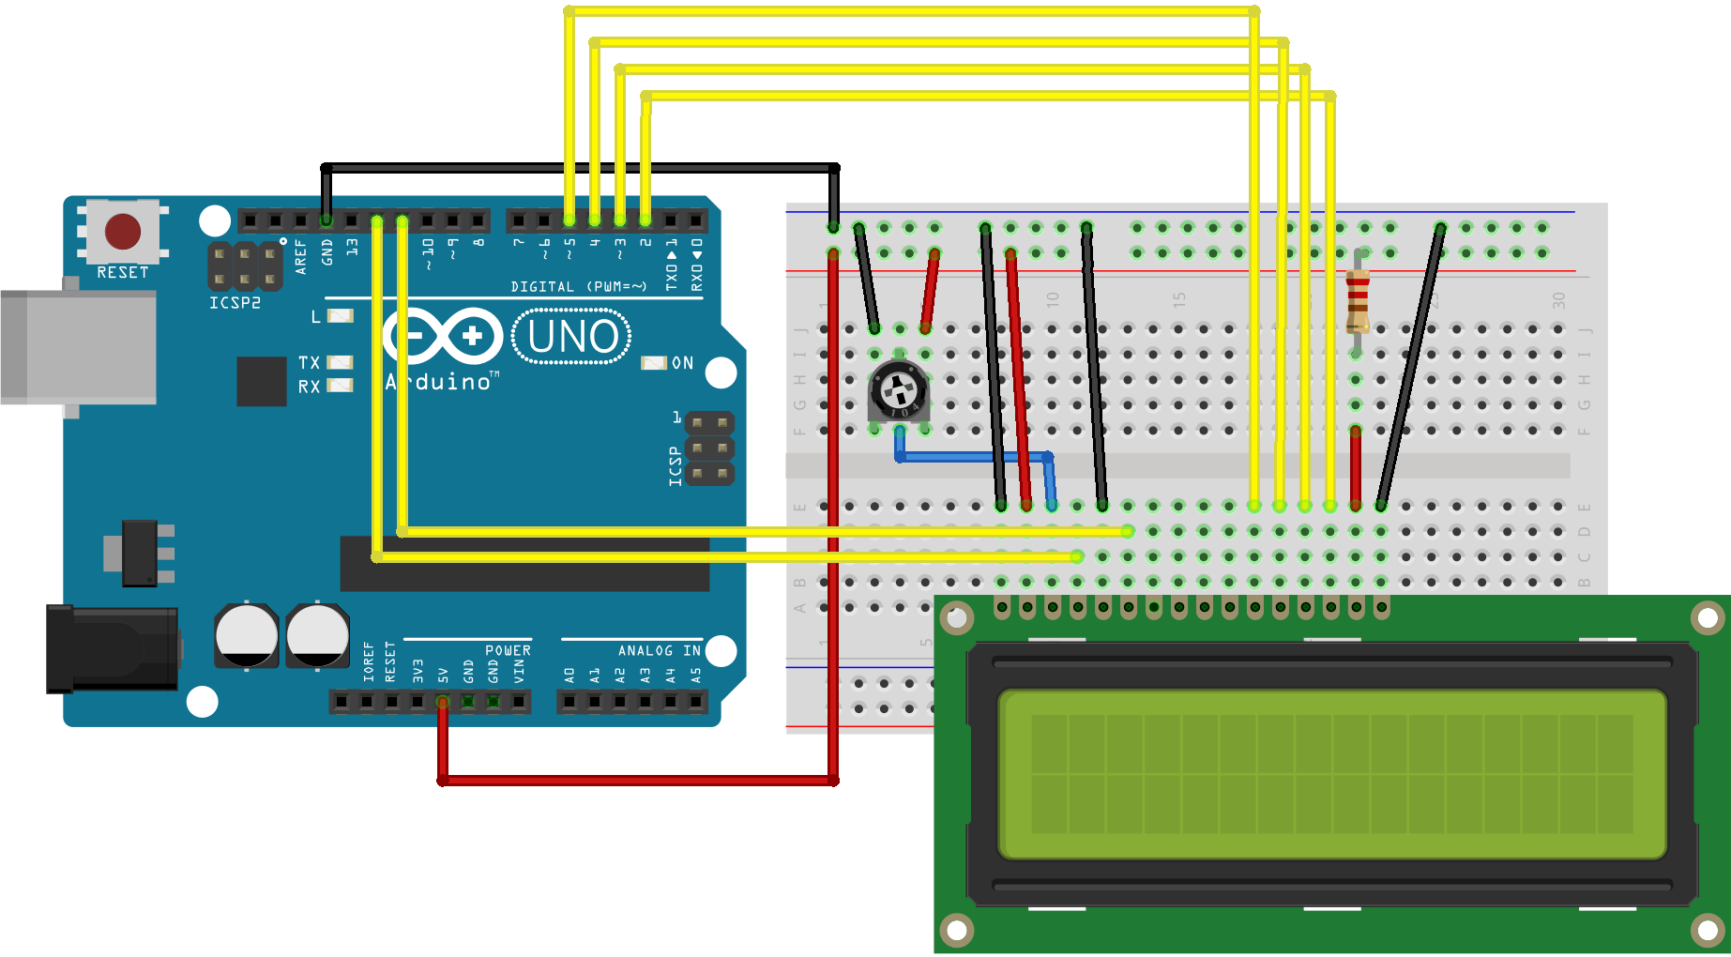
Connection diagram

Slide 4

It’s coding time

Slide 5
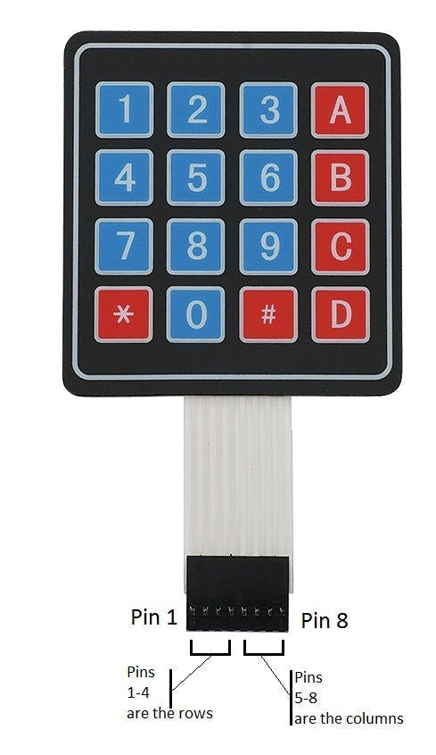
Keypad
A keypad is a set of buttons arranged in a block or "pad" which bear
digits, symbols or alphabetical letters.
Used in security system for
press the password

Slide 6
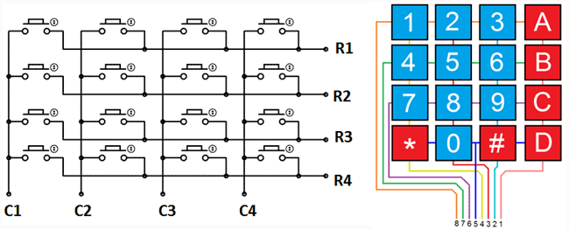
keypad contd……
It is 4*4 keypad which
is combination of 4 ROW &
4 column
For example: TO press
Number 1 there must be

Slide 7
Components required
Arduino Uno
Keypad
jumper

Slide 8
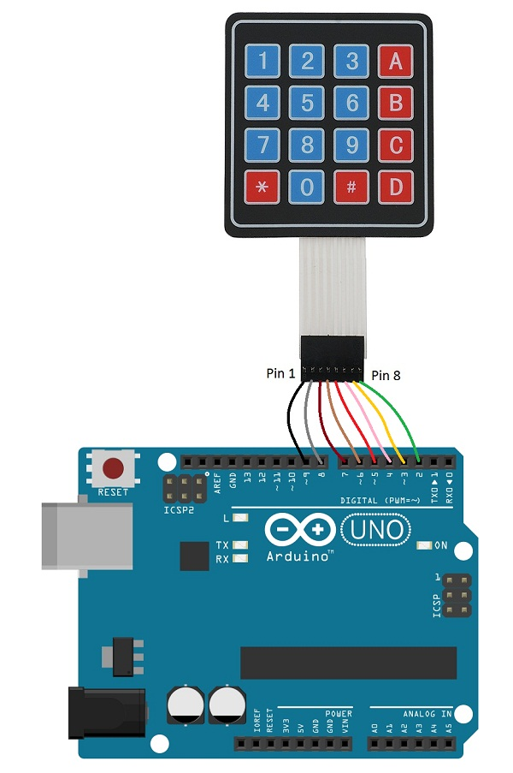
connection diagram

Slide 9
It’s coding time

